Slide 1
Affirming Mental Healthcare for LGBTQ+/POC: Understanding the Importance of Client Identities
Acknowledgements: Content in this presentation was provided in part by Dr. Adam Gonzalez, Dr. Allison Eliscu, and Rose Cardin

Slide 2

L
E
S
B
I
A
N
G
A
Y
B
I
S
E
X
U
A
L
T
R
A
N
S
G
E
N
D
E
R
Q*
U
E
E
R
Sexual Orientation & Gender Identity
Sexual Orientation
Gender Identity

Slide 3
Terminology
Sex assigned at birth or Birth Sex- male/female/ intersex based on reproductive organs and genitalia at birth.
Gender identity- one’s own feeling, internal sense of being man, woman or in-between. Can change over time
Gender expression- external manifestations of gender – person’s name, pronouns, clothing, haircut, etc.
Gender expression ≠ Gender identity
Sex ≠ Gender

Slide 4
Terminology
Transgender- Individuals whose gender identity and/or gender expression differs from what is typically associated with the sex they were assigned at birth.
    Female to male (Transgender Male/Trans Man)
      -Female at birth, identify as male
    Male to female (Transgender Female/Trans Woman)
    -Male at birth, identify as female
    Non-binary – individual whose gender identity isn’t exclusively male or
    female
    Gender queer
Cis-gender – a term for people whose gender identity matches the sex they were assigned at birth.

Slide 5
Terminology
Gender Affirmation- The act of changing one’s gender expression to match their gender identity
  Changing hairstyle or clothing
  Changing name and pronoun use
  Changing name/gender on legal documents
  Masculinizing and Feminizing Hormones
  Gender confirmation surgery (avoid the term sex change)

Slide 6
Terminology
Sexual Orientation: refers to physical, romantic and/or emotional attraction
    Gay- Describes a person attracted to someone of the same gender
    Lesbian- Describes a woman attracted to other women
    Heterosexual- Describes a person attracted to someone of a different gender
    Avoid using the term ”sexual preference”; “homosexual”

Slide 7
Terminology
Sexual Orientation: refers to physical, romantic and/or emotional attraction
    Bisexual (bi)- Describes a person attracted to people of multiple genders; attracted to men and women.
    Asexual- Describes an individual who does not experience sexual attraction
    Queer- Used by some to describe an individual whose sexual orientation is not exclusively heterosexual; also used to describe gender identity
Coming Out: Lifelong process of self-acceptance and disclosure of one’s identity to others. Varying degrees of outness.
Do Not Assume that Sexual orientation/attraction = Behaviors

Slide 8
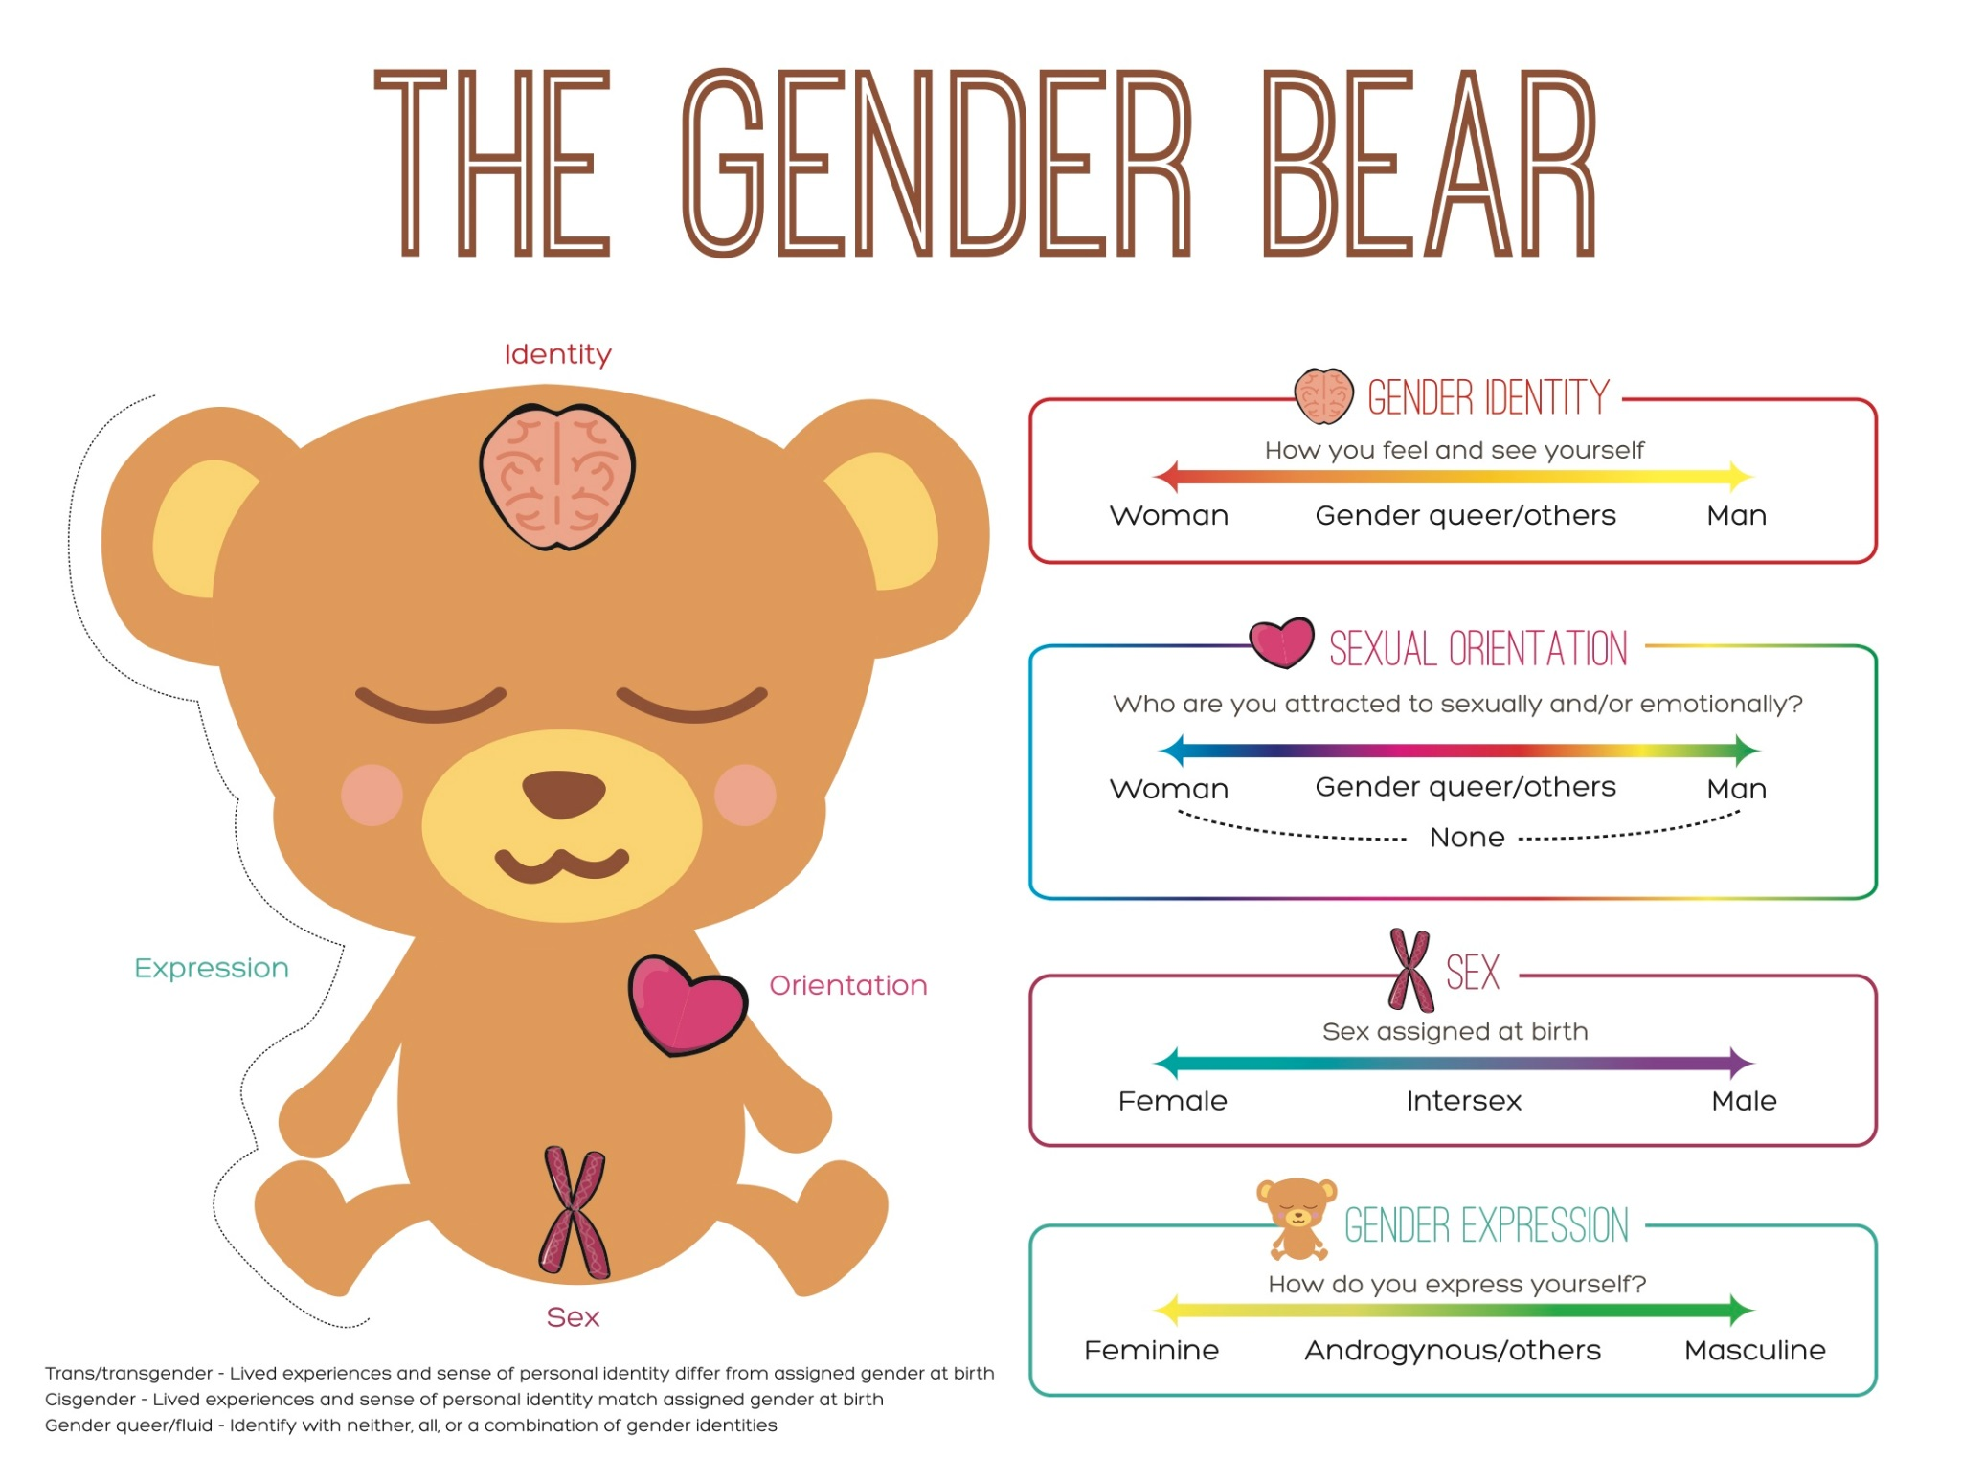

Slide 9
Why Does This Matter?

Slide 10
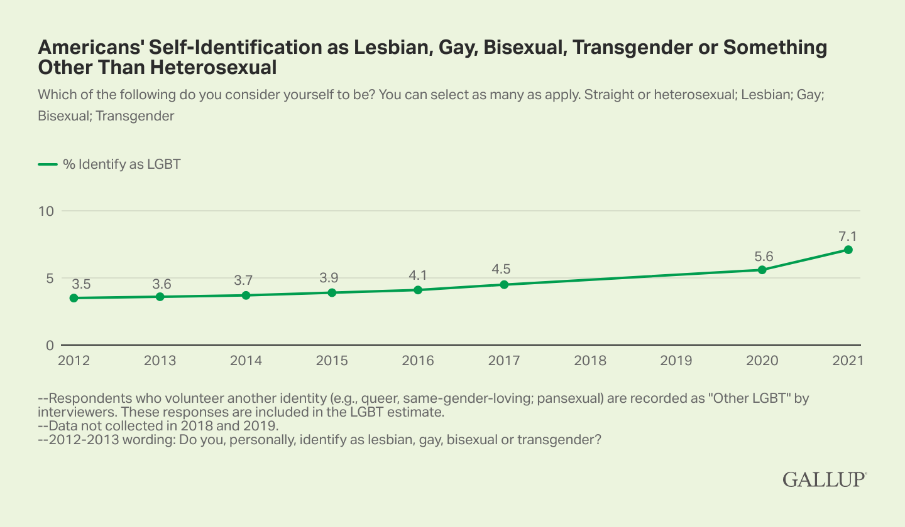
LGBT Prevalence
Notes:
Please note, queer individuals were not identified in these studies and it is an identity increasingly used in the population

Slide 11
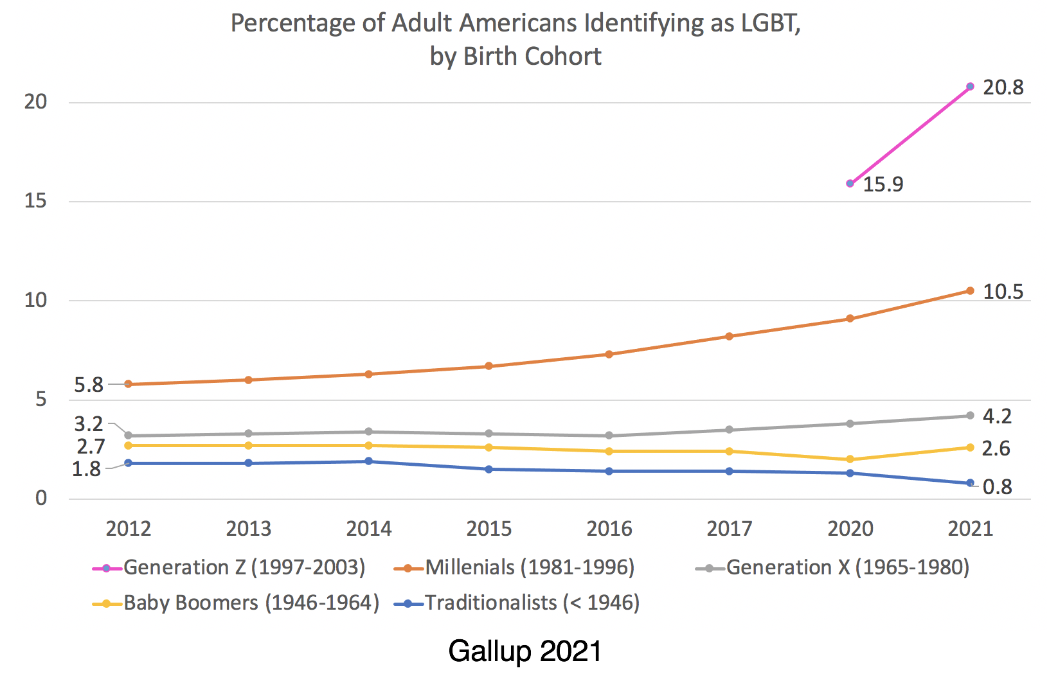
LGBT Prevalence

Slide 12

Case – Tim
You are a provider in a psych ER and your next patient has just arrived. The nurse tells you, “This young man has been brought in by his mother for engaging in self-harming behaviors and worsening depression”.
In the room, the patient introduces themselves as Tim. You open the electronic medical record and the chart says the name ‘Tiffany’.
You say, “Oh, I think we opened the wrong chart,
do you have a sister named Tiffany?”
The patient turns red, looks at the ground, and says,
“Uh, no that’s me, but I go by Tim and I’m non-binary.”

Slide 13
Case - Discussion
What was your reaction when the patient said his name was “Tim” and disclosed identity as non-binary?
How do you think Tim felt at that moment?
Understand and confront personal biases
Provider discomfort can interfere with providing good medical care
It is an ethical obligation to treat all patients respectfully
Notes:
Discussion Questions:
What was your reaction when the patient said his name was “Tim”?
How do you ask a patient about their gender when you are confused?
It is perfectly fine to ask a patient how they identify their gender if you are unclear. Don’t worry if you are confused. The important thing is to be open-minded and supportive.
Some things that you could say are:
“What pronouns do you use?”
“How do you identify your gender?”

Slide 14
Case - Discussion
How do you ask a patient about their gender when you are confused?
    What name do you use?
    What pronouns do you use?
    How do you identify your gender?
Tim
He/him
Male
Do Not Assume
Be Supportive
Notes:
Discussion Questions:
How do you ask a patient about their gender when you are confused?
It is perfectly fine to ask a patient how they identify their gender if you are unclear. Don’t worry if you are confused. The important thing is to be open-minded and supportive.
Some things that you could say are:
“What pronouns do you use?”
“How do you identify your gender?”

Slide 15
Case – Tim
Based on your assessment, you determine that Tim is at elevated risk for suicide given past attempts, current ideation, plan and intent. Tim will need an admission.
How do you refer to this patient when documenting in the EHR?
“Tim is 16 years old and identifies as non-binary (female sex assigned at birth). They are presenting with worsening depression and suicide ideation with a plan and intent.”
Notes:
Discussion Questions:
You should refer to patients with their stated pronouns, even if their record says otherwise. In your patient note, it is appropriate to mention the patient’s sex assigned at birth and their gender identity.

Slide 16
Case - Discussion
A nearby facility is called to check if they have a bed. The facility has bed availability (YES!) and gender segregated units.
  How do you handle the conversation with the facility and with Tim?
  What are some important considerations?
        Tim’s preferences? Safety concerns?
Notes:
Discussion Questions:
Is it relevant to discuss the patient’s gender with the new provider? The best course of action is to ask the patient what they would prefer. Even though it may not necessarily be clinically relevant to Tim’s care, he might appreciate your saving him from another potentially uncomfortable discussion with a new provider; however he might prefer to tell the new provider himself instead.
How can you make sure that your future practice is accessible and welcoming to all patients? Is there anything that you can do now as a provider?

Slide 17

Importance of Pronouns

Slide 18


Avoid Assumptions
Do NOT assume:
  Patients are heterosexual
  Orientation/Attraction equals behavior
  Sexual orientation based on gender of partner
  LGBTQ+ patients are engaging in risky behavior
  LGBTQ+ patients have unsupportive families
  Sexual orientation or gender identity based on appearance
  All transgender individuals want to undergo surgery

Slide 19
Ask the Right Questions
What is your current gender identity?
  Man
  Woman
  Transgender man
What was your sex assigned at birth?
  Male
  Female
  Intersex
  Transgender woman
  Gender queer
  Nonbinary, gender fluid

