Slide 1
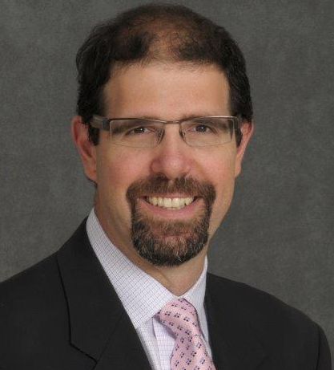
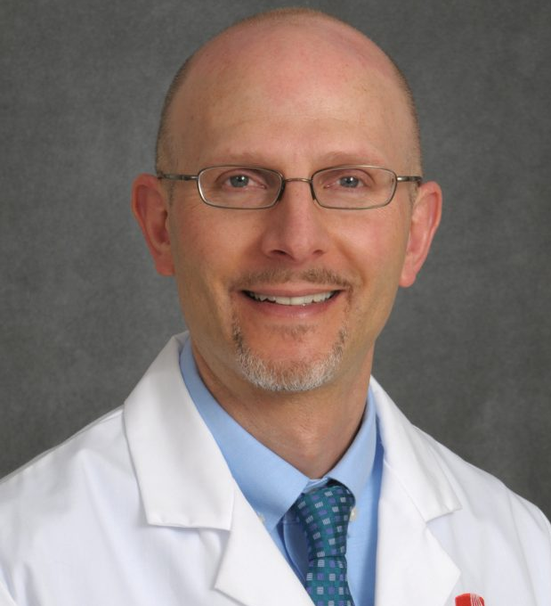
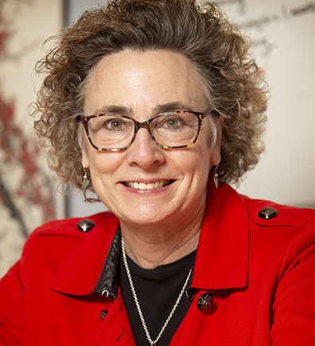
STONY BROOK MEDICINE TASK FORCE
CO-CHAIR
CO-CHAIR
MODERATOR
  Aaron Sasson, MD
  Professor, Dept. of Surgery
  Chief, Division of Surgical Oncology, SOM
  David Thanassi, PhD
  Professor and Chair, Dept. of Microbiology & Immunology, SOM
  Rose Martinelli
  Vice President for Strategic Initiatives

Slide 2
STONY BROOK MEDICINE TASK FORCE
MISSION
SCHOOL OF DENTAL MEDICINE
SCHOOL OF HEALTH TECHNOLOGY & MANAGEMENT
RENAISSANCE SCHOOL OF MEDICINE
SCHOOL OF NURSING
SCHOOL OF SOCIAL WELFARE
STONY BROOK HOSPITALS AND
CLINICAL NETWORK
Achieving Financial Sustainability
INFORMATION
stonybrook.edu/financial-sustainability
CO-CHAIRS
David Thanassi
Aaron Sasson

Slide 3
Scope
STONY BROOK
MEDICINE
David Thanassi
Aaron Sasson
  Organizational structure of Stony Brook Medicine, the Health Sciences, and
  Stony Brook University Hospital and network of affiliated hospitals
  Provide recommendations relevant to decision making and strategic planning of
  Stony Brook Medicine, the Health Sciences, Stony Brook University Hospital and network
  of affiliated hospitals
  Funds flow optimization to support the research, clinical and educational missions of
  Stony Brook Medicine
  Research support and development within the five Health Sciences schools and across the University (Research & Innovation Task Force)
  Educational mission and programs of Stony Brook Medicine (Academic Portfolio Task Force)

Slide 4
Who Is Involved — TF Members
STONY BROOK
MEDICINE
David Thanassi
Aaron Sasson
Co-Chairs
  David Thanassi, PhD
  Professor and Chair,
  Dept. of Microbiology & Immunology, SOM
  Aaron Sasson, MD
  Professor,
  Dept. of Surgery
  Chief, Division of Surgical Oncology, SOM
  Administrative Support
  Shaneen Washington, MS
  Executive Assistant, SOM
Members
  Michelle Ballan, PhD Professor and Assoc. Dean for Research, SSW
  Patricia Bruckenthal, PhD, APRN-BC, FAAN Assoc. Dean for Research and Innovation, SON
  Evan Jones, MD Chair, Dept. of Dermatology, SOM
  Lisa Kayser, MS, PAC Director of Pre-Clinical Education, SHTM
  David Lam, MD, DDS, PhD Chair, Dept. of Oral and Maxillofacial Surgery, SDM
  Eric Lamberg, EdD, PT, Cped Dept. of Physical Therapy, Associate Dean, SHTM
  Joshua Miller, MD, MPH Dept. of Endocrinology and Metabolism; Asst Dean for Clinical Integration, SOM
  Susmita Pati, MD, MPH Division Chief, Dept. of Pediatrics, SOM
  Memming Park, PhD Dept. of Neurobiology and Behavior, SOM
  Maryanne Reinhardt Chief Financial Officer, FSA
  John Riley, MBA Assoc. Vice President, Health Sciences; Vice Dean, Administration and Finance, SOM
  Carolyn Santora, MS, RN Chief, Regulatory Affairs; Chief Nursing Officer, SBUH
  Jessica Seeliger, PhD Dept. of Pharmacological Sciences, SOM
  Ally Silver, FACHE, MPH Assoc. Director Operations, Surgery, SBUH
  Sherilyn Towne, MS Assistant Dean for Administration and Finance; Lecturer, SON
  Stella Tsirka, PhD Dept. of Pharmacological Sciences; Vice Dean for Faculty Affairs, SOM
  Stephen Walker, PhD Dept. of Oral Biology and Pathology; Director of Research Compliance, SDM
  Kelly Warren, PhD Dept. of Physician Assistant Studies, SHTM
  Thomas White, PhD Dept. of Physiology and Biophysics, SOM

Slide 5
Who Is Involved —
ACC Consultants
STONY BROOK
MEDICINE
David Thanassi
Aaron Sasson
To assist the Task Force, an outside review of Stony Brook Medicine was commissioned from the Academic Advisory Council (AAC)
AAC Consultants:
  Arthur Rubenstein, Professor of Medicine, former Dean and EVP, Perelman School of Medicine, University of Pennsylvania
  Tom Lawley, Professor of Dermatology, former Dean, Emory School of Medicine
  Phil Pizzo, Professor of Microbiology and Immunology, former Dean, Stanford School of Medicine

Slide 6
What We Have Learned
STONY BROOK
MEDICINE
David Thanassi
Aaron Sasson
We have a strong, vibrant and diverse health sciences enterprise that is committed to excellence in research, education and clinical care.
There are many opportunities for growth, and these must include all the health sciences schools.
Governance considerations for SBM should be done with the intent of maximizing the strategic missions of all the health sciences schools.
The clinical presence and growth of Stony Brook in the region (clinically integrated network) is vital to our mission.
The research and educational missions of SBM must be evaluated for improved support and the development of new opportunities.

Slide 7
Opportunities
STONY BROOK
MEDICINE
David Thanassi
Aaron Sasson
  SBM governance and communication
  Hospital funds flow and resource allocation
  Expand clinical practice and billing to all the health sciences schools
  Improve resources and support across the SBM professional schools
  Increase and incentivize faculty research productivity
  Expand training and clinical rotation opportunities within SBUH and affiliates
  Funding for basic science departments and faculty
  Policies and expectations in SBM professional schools
  Build cross-campus collaborations and integration

Slide 8
What’s Next? Working Groups
STONY BROOK
MEDICINE
David Thanassi
Aaron Sasson
Expanded Clinical Enterprise
Ensure all health sciences schools have access to clinical practice activities and billing through
the clinical practice platform
Co-Chairs
Lisa Layton, CPMP Controller
Spencer Busia, Assistant Dean, Dental School
Expanded Training and Clinical Rotation Opportunities
Explore how to expand training and clinical rotation opportunities for members of the health sciences schools at SBUH and affiliates
Co-Chairs
John Riley, AVP Health Sciences, Vice Dean, Administration and Finance
Carolyn Santora, Chief of Regulatory Affairs, Chief Nursing Officer

Slide 9
Additional Working Groups
STONY BROOK
MEDICINE
David Thanassi
Aaron Sasson
Improve Resources and Support Across the SBM Professional Schools
Investigate infrastructure and support needs and how best to distribute resources and share costs among the different health sciences schools; expand philanthropic support for all SBM schools and programs
Co-Chairs: TBD
Understand SBM Funds Flow and Resource Allocation
Examine current CPMP structure and review possible changes to optimize utilization and distribution of funds to support the clinical, research and academic missions of SBM; examine and review distribution of state salaries for clinical faculty
Support in funds flow analysis will be provided
Co-Chairs: TBD

Slide 10
Survey Update
STONY BROOK
MEDICINE
David Thanassi
Aaron Sasson
54%
T/TT faculty
NTT faculty

Slide 11
Q&A

