Slide 1
CONTINUING, PROFESSIONAL, AND EXECUTIVE EDUCATION PROPOSAL
March 30, 2021

Slide 2
Table of Contents
New/
Increased Revenues
Process Improvements & Training
Cost
Reductions
Proposal Description
Current State
What We Learned
Preliminary Recommendations
Benefits / Risks
Implementation Considerations
This initiative presents a revenue opportunity for SBU.

Slide 3
Membership and Participation
Proposal Description
1
Working Group Co-Chairs:
Sarah Jourdain: Associate Professor, Chair, European Languages, College of Arts and Sciences
Karen (Kayla) Mendelsohn: Assistant Dean for Academic and Student Affairs, School of Health Technology and Management
Working Group Members
Dolores Cannella Jennifer Davidson Carol Della Ratta Peter Donnelly Kathleen Ehm Stacey Finkelstein Perry Goldstein Tracey Iorio Angela Kelly Chris Kretz Kenneth Lindblom | Laura Lindenfeld Robert Mangione Joanmarie Maniaci Elizabeth Newman Derek O’Connor Emmanuelle Pales-Espinosa Robert Reeves Stanislav Uryasev Deborah Zelizer
Additional SBU Participants
Kimberley Dixon Daniela Flesler Braden Hosch Myra Intoci Lori Kie Eric Lamberg Dorothy Lane Andrea Lipack Pat Malone Marianna Savoca Urszula Zalewski
This process engaged stakeholders from over 20 colleges, schools, and units across SBU (e.g., College of Arts and Sciences, College of Business, Renaissance School of Medicine, School of Professional Development, Career Center). In addition to the 22 Working Group members, we also engaged a variety of additional stakeholders through one-on-one interviews and guest speaker presentations.

Slide 4
Proposal Overview
Proposal Description
1
Initiative Type: Revenue Opportunity to expand SBU’s impact in continuing, professional, and executive education (CP&EE).
Working Group Charge | Problem Statement | Opportunity
Document existing professional, continuing and executive education programs Identify current constraints and potential barriers to the expansion of such programs Consider the potential role of partnerships in complementing in-house capabilities Consider governance, policies, and processes Consider the capabilities and skill sets involved in developing and delivering CP&EE programs | SBU must identify opportunities to expand and build new revenue streams Expanding Stony Brook’s impact in CP&EE can help to generate increased net revenues and contribute to educational and economic development objectives Achieving these objectives will require greater alignment and collaboration, and will be dependent upon select strategic investments to generate Return on Investment (ROI) | Building on its success to date, SBU will become the unrivaled leader in CP&EE on Long Island by 2030 SBU can engage with its 200,000 alumni and other audiences to build and expand a portfolio of continuing education and lifelong learning opportunities SBU will extend its competencies in blending internal strengths with partners’ capabilities

Slide 5
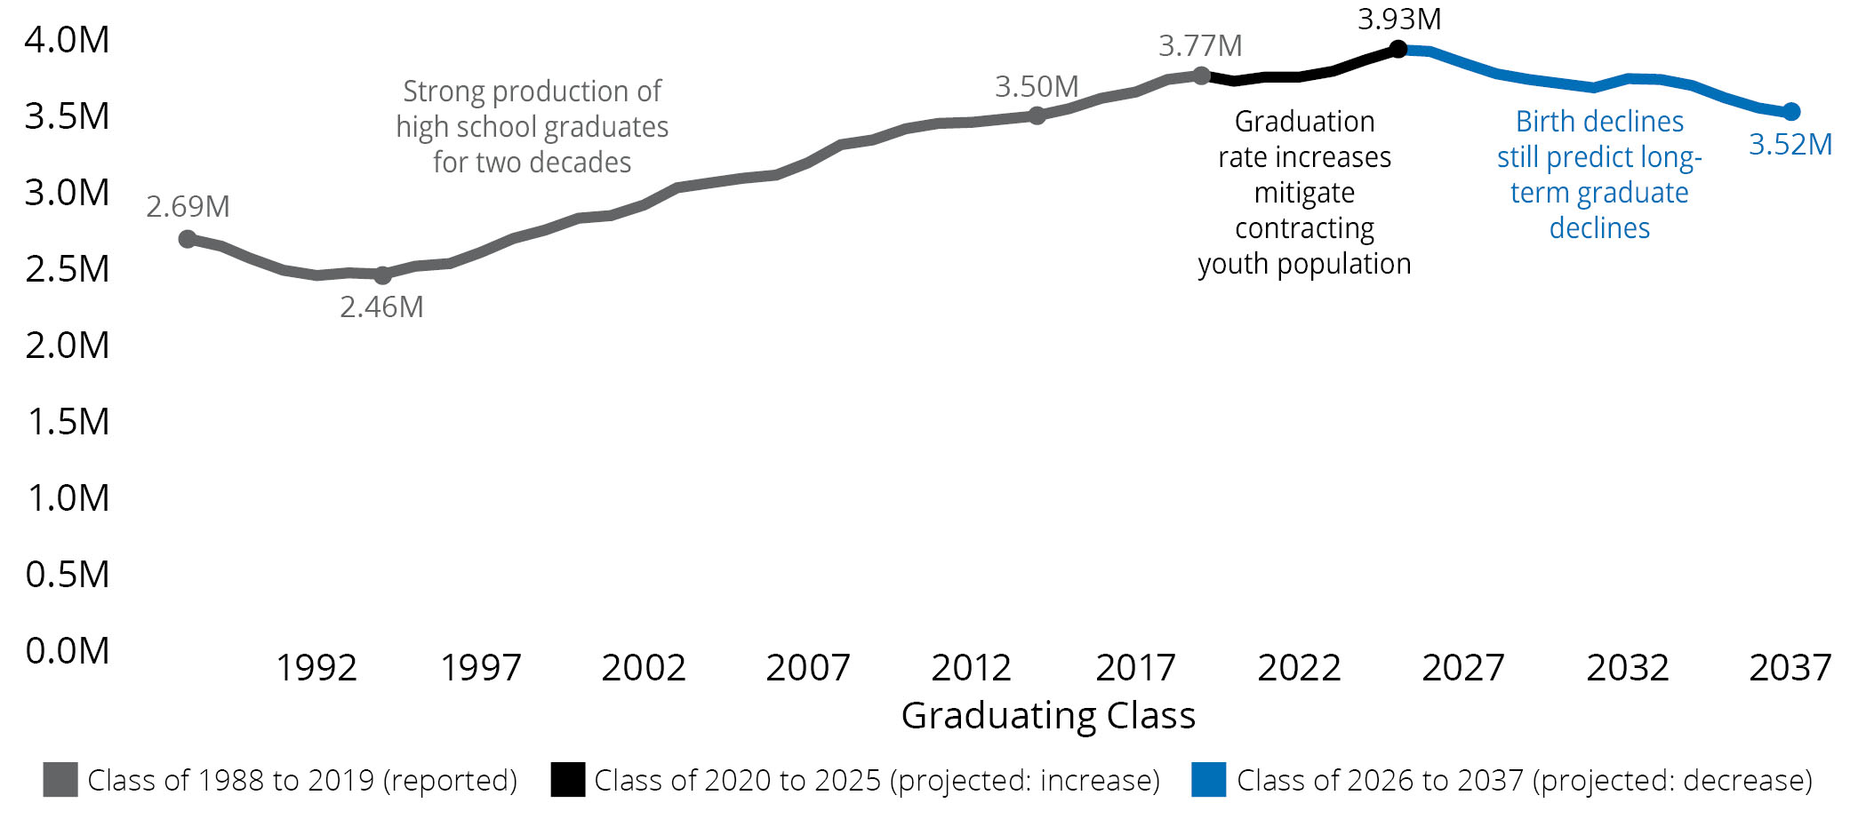
Market Opportunity
Proposal Description
1
Anticipated demographic and economic shifts present challenges for higher education while creating a compelling case for enhanced focus in continuing, professional, and executive education.
The undergraduate student population is estimated to drop by ~10% or more between 2019 and 2037 due to declining birth rates and high school graduating classes.
From 2026-2037, there will be a steady decline in high school graduates, in alignment with birth rate trends.
Half of the states in the Northeast are anticipated to have declining or stagnant graduating classes.
The number of graduates in New York is projected to remain stagnant or experience minor increases until the birth declines in the mid-2020s, when the regional downturns are projected to worsen.
Demographic shifts will also be accompanied by significant changes in the global economy. By 2030, an estimated 375 million workers (14% of the global workforce) will likely need to switch occupations and re-skill due to market forces including automation and digitization.¹
Based on the market conditions and anticipated demographic trends, an increased focus on graduate programs could help SBU to offset a projected drop in undergraduate enrollment and address critical workforce needs.
Data and Image Source: https://knocking.wiche.edu/report/
1. McKinsey, “Retraining and reskilling workers in the age of automation.”

Slide 6



Revenue Opportunity
Proposal Description
1
Continuing, professional, and executive education presents a significant revenue opportunity for SBU, as evidenced by the scale and success of leading regional and national players in this space.
Stony Brook University
90+ graduate programs and 55 graduate certificates 40+ offerings through the School of Professional Development and the Center for Corporate Education SPD serves 3,000 graduate students and 5,500 non-credit students Professional and continuing education produced estimated revenues of ~$5M in 2019¹
Georgia Tech Professional Education (GTPE)
GTPE has been a provider of continuing education for 100+ years Over 600 courses and bootcamps, 63 professional and graduate certificate programs, 13 online degree programs 129,000 learners in 2020 including 21,000 graduate degree learners and 99,000 MOOC learners 231 staff, 330 faculty, and 422 instructors
NYU School of Professional Studies (NYUSPS)
NYUSPS has been a provider of continuing education since 1934 25 graduate online degrees, 14 online for-credit certificates, 51 non-credit certificate programs, and courses in 32 subject matters 30,000+ students annually 27,000+ alumni 35,000+ attendees for on-site and online events and programming
~$5M-10M
CP&EE Revenues
~$100M-150M
1. SBU Financial Sustainability Update presentation (12/22/2020)
2. https://pe.gatech.edu/sites/default/files/GTPE-by-the-Numbers-FY20.pdf
3. https://www.sps.nyu.edu/content/dam/sps/communications/Annual_Report_2019-2020.pdf

Slide 7

Progress to Date
Proposal Description
1
The CP&EE Working Group has made significant progress in building a current state understanding of existing activity at Stony Brook and identifying potential avenues for future action.
Increased general awareness of the CP&EE at Stony Brook
Identified gaps and opportunities in Stony Brook’s current CP&EE organizational capabilities
Drafted a working taxonomy to categorize CP&EE offerings
Surfaced governance, policy, and process considerations
Developed a working inventory of existing CP&EE offerings
Explored potential near and longer-term organizational models to enhance growth and impact
Increased understanding of the competitive landscape for CP&EE
Identified opportunities to minimize barriers and increase coordination
Increased awareness of potential partnership and program delivery models
Fostered productive dialogue among a diverse group of CP&EE stakeholders

Slide 8
Current State Overview
2
Current State
Stony Brook’s distributed current state model prioritizes local control and quality assurance of CP&EE programming; however, the model is not optimized for scale.
Benefits | Limitations
Colleges and schools have local control and agency to develop tailored offerings Program approval structure prioritizes academic quality The School of Professional Development (SPD) has established partnerships with other colleges and schools | Distributed ownership and limited awareness of CP&EE programs across the University Limited communication and coordination among units for CP&EE Revenue-share model could more effectively incentivize collaboration and innovation Limited capacity and support for marketing, market research, and technology infrastructure Program approvals are time-consuming and limit market-responsiveness

Slide 9




Organizational Model Options
2
Current State
Transitioning to a more integrated model may bring existing assets and units into greater coordination, minimize transactional friction and barriers to impact, and stimulate near-term growth in CP&EE without creating significant cultural and organizational disruption.
Largely Integrated Model | Hybrid Model | Largely Independent Model
CPE unit works closely with other institutional units to develop, deliver, and market their programs Lower degree of central support structure for CPE Tuition revenue flows through other institutional units | Institutional resources assist with some program development, delivery and administration for CPE programs Higher degree of support from CPE unit CPE unit helps maintain consistency across offerings Tuition revenue models vary | CPE unit operates as a distinct yet complementary institutional brand Programs developed and administered by central unit Dedicated faculty and staff and substantial infrastructure Tuition revenue flows through CPE unit
More Integrated
More Independent
Notes:
Most CPE units do not include executive education, which is often housed in business schools.
This visual aid is a rough, linear approximation. The degree of integration / independence of an institution’s continuing and professional education organizational model is multi-dimensional.

Slide 10
CP&EE Working Taxonomy
2
Current State
 | Taxonomy L1
 | Taxonomy L2
 | Taxonomy L3
 | Future State
The Working Group developed a working taxonomy to categorize various current state CP&EE activities at SBU. This taxonomy informed the creation of our working inventory of offerings.
Academic Credit Offerings
Credits appear on a formal transcript and some form of credential is awarded
Non-Credit Offerings
Offerings do not earn formal academic or credit
DRAFT AS OF 2/23/21
NOTES
Modality (e.g., online, in-person, hybrid) is considered an attribute of CP&EE offerings and will be captured in the inventory but is not a category in the taxonomy because many offerings are provided in multiple formats.
Pre-college offerings (e.g., high school) are not in scope for this effort.
“Credit bearing certificates must be approved by SUNY and registered with NYSED. All credits must be applicable toward a degree program at the issuing institution. Noncredit certificates need no external approval and must be identified as such.”²
The CP&EE Inventory will be finalized based on this taxonomy.
Continuing Education
Credits are not reflected on a transcript but meet external accrediting requirements
Professional Development
Offerings do not earn formal academic or continuing education credits
Seminars, Workshops,
& Trainings (PD)
Often tailored for a specific audience or customer
e.g., Analytics with Excel
Master’s Degree Programs
Professional master’s degree programs
offered online or hybrid
e.g., MS in HR Management
4
6
1
Seminars, Workshops,
& Trainings (CEU)
Individual online or in-person events, which meet external accrediting requirements
e.g., Continuing Medical Education
7
Graduate Certificates (For-Credit)¹
Formal certificate program that grants an official,
for-credit Stony Brook credential
e.g., Graduate Certificates- Coaching
Non-Credit Certificates
Offerings that award certificates of participation
but no formal credential
e.g., Project Management Certificates
2
PDU Conversion³
5
Courses (CEU)
Standalone courses in a variety of formats, which
meet external accrediting requirements
e.g., Grand Rounds
Other Courses (Non-Credit)
Miscellaneous non-credit and non-CEU offerings
e.g., audited courses
3
8
Courses (For Credit)
Courses that may be taken individually and result
in Stony Brook academic credit
e.g., Post-Baccalaureate Study- Pre-Health
PDU Conversion
Micro-Credentials
Credit-bearing offerings that signify that specific skills/competencies note such on a transcript
e.g., Micro-Credential in Leadership
Micro-Credentials
Non-credit offerings that signify that specific skills/competencies have been achieved
e.g., Digital Badges
The working CP&EE taxonomy was developed to provide Stony Brook stakeholders a common language, build a shared understanding, and guide discussion about the future of CP&EE at the University. Categories of activity are cross-disciplinary.
1. Includes some offerings with level 4 categorization, which designates NYSED. For simplicity purposes, level 4 categorization is excluded from this diagram. 2. Source: SUNY Micro-Credential Definition and Terms. 3. Professional Development Units may be converted to CEUs

Slide 11
Current CP&EE Activity
2
Current State
The draft heat map captures the variety of CP&EE offerings currently offered across SBU¹.
 | Academic Credit Offerings |  |  | Non-Credit Offerings
 |  |  |  | Continuing Education Units (CEUs) |  | Professional Development (PD)
CSU | 1. Degree Program | 2. Graduate Certificate (For Credit) | 3. Courses (For Credit) | 4. Seminar, Workshop, or Training (CEU) | 5. Course (CEU) | 6. Seminar, Workshop, or Training (PD) | 7. Non-Credit Certificate | 8. Other Courses (Non-Credit)
Center for Corporate Education² |  |  |  | X | X | X | X | X
College of Arts and Sciences | X | X
College of Business | X |  | X
College of Engineering and Applied Sciences | X | X
Graduate School | X | X
Program in Public Health | X | X
Renaissance School of Medicine | X | X |  | X | X
School of Communication and Journalism | X | X |  | X | X | X |  | X
School of Dental Medicine |  | X |  |  | X
School of Health Technology and Management | X | X |  | X |  |  | X | X
School of Marine and Atmospheric Sciences | X | X
School of Nursing | X | X |  | X
School of Professional Development | X | X |  | X | X | X | X | X
School of Social Welfare | X |  |  | X |  | X
Southampton Arts | X | X |  |  |  | X
Total³ | 51 | 53 | 5 | 14 | 5 | 25 | 11 | 6
DRAFT AS OF 2/23/21
1. Includes CSUs for which data was available; includes Master’s programs in which part-time study is available based on descriptions on Stony Brook websites. 2. Center for Corporate Education CEUs are PDUs that can be converted to CEUs. 3. These preliminary figures are likely incomplete due to the distributed nature of the portfolio.

Slide 12
What We Learned
What We Learned
3
While there is enthusiasm about the future potential of CP&EE at SBU, there is limited awareness of existing offerings and coordination of program development and delivery across campus.
There is no dominant player in CP&EE on Long Island, which presents an opportunity for SBU to capture significant market share in this space. Other institutions on Long Island, including Hofstra University and Long Island University, have relatively modest footprints in CP&EE in the current state
CP&EE presents a substantial revenue opportunity but will require greater alignment and collaboration and select strategic investments in key areas
The Working Group highlighted the need for greater integration, collaboration, and sharing of capabilities in the near-term
The Working Group prioritized capabilities including marketing, market research, and support services for more equitable access and greater coordination and increased investment
The Working Group also surfaced the need for a coordinated partnering strategy to best complement in-house capabilities
The Working Group identified several barriers to organizational change including financial resources, organizational complexity, and the absence of a University-level articulation of mission and vision for CP&EE

Slide 13
Preliminary Recommendations
Preliminary Recommendations
4
Preliminary recommendations to enhance CP&EE in the near-term (i.e., 2021-2024).
Preliminary Recommendations for CP&EE
Align on the Big Opportunity for CP&EE at Stony Brook
B. (1) Short term: Create a CP&EE Implementation Task Force, with a designated leader, to implement deliverables; (2) Longer term: Form an Office of CP&EE, recruit an Executive Leader and staff with relevant expertise, and establish a Steering Committee
C. Maintain and Evolve a Taxonomy for CP&EE
D. Maintain and Evolve an Inventory of CP&EE Offerings
E. Develop and Implement Policies and Processes to Support CP&EE
F. Increase Data Visibility
G. Identify and Invest in Shared Capabilities
H. Design a Partnering Strategy to Complement In-House Capabilities
The formation of the CP&EE Steering Committee with a designated leader will be critical to the success of the broader CP&EE effort. This body will provide oversight and coordination, guide the development of a future-state organizational model, and support improved efficiency and growth across the organization.

Slide 14
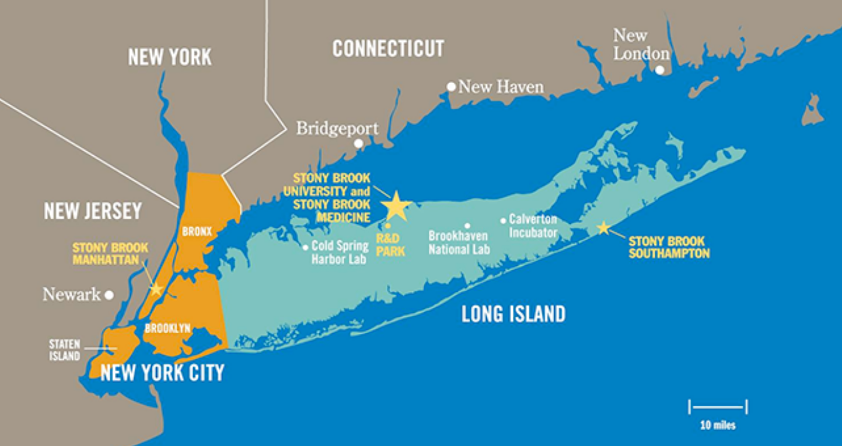
The Big Opportunity: Future State Vision
Preliminary Recommendation
4A
Building on its success to date and its reach from Manhattan to Southampton, Stony Brook will become the unrivaled leader in CP&EE on Long Island by 2030 by addressing unmet consumer needs and driving regional economic growth. In so doing, Stony Brook can connect its 200,000 alumni and other audiences to a portfolio of relevant continuing education and lifelong learning opportunities.
To expand growth and impact in CP&EE, Stony Brook will extend its competencies in blending internal strengths with partners' capabilities. Stony Brook will build its reputation in this area both as an independent actor and as a nimble integrator of internal competencies and external partnerships that deliver value to a vast community of learners.
Image: https://healthtechnology.stonybrookmedicine.edu/programs/pa/elpa/admissions/directions

Slide 15
Form an Office for CP&EE including an Executive Leader and a Steering Committee
Preliminary Recommendation
4B
Current State | Future State
Limited cross-functional collaboration and coordination of best practices No dedicated University organization for CP&EE programs | The Office of CP&EE will: Advocate for CP&EE stakeholders Promote equitable access to resources Facilitate dissemination of best practices Report on performance metrics Provide oversight and guidance on near and longer-term organizational model development
Short-term (1-6 months): Convene a CP&EE Implementation Task force, with designated leader, to put in place short-term solutions and to transition to a longer-term strategy
Create an Office of CP&EE, with leadership and staff, to spearhead and shepherd continued growth, advised by the Steering Committee
Appoint a designated leader for CP&EE and Convene CP&EE Steering Committee
Key Recommendation Steps

Slide 16
Role of the CP&EE Steering Committee
Preliminary Recommendation
4B
We anticipate the University will want to form a cross-functional CP&EE Steering Committee, with a designated leader at the Vice Provost level, to promote shared oversight and minimize barriers. Refinements will come through dialogue with SBU Executive Leadership.
Roles and Responsibilities of the CP&EE Steering Committee
  Provide oversight and leadership
  Champion values
  Advocate for CP&EE stakeholders
  Steward a balanced portfolio recognizing that not every offering will generate net-surplus revenue
  Develop process for approving non-credit offerings building upon current shared governance
  Provide access to incentives
  Promote equitable access to resources
  Facilitate dissemination of best practices
  Oversee portfolio of external partnerships and evaluate new partner opportunities
  Report on performance metrics and maintain accountability
Composition of the CP&EE Steering Committee
  Representatives from various colleges, schools and units across SBU, including faculty in diverse areas
  Representatives from relevant units (e.g., CELT, Marketing, Alumni Relations, Career Services)
  This committee requires leadership, likely at the Vice Provost level
  This body may report into the Provost's Office, the Vice President for Strategic Initiatives, or another unit, pending discussion by Executive Leadership

Slide 17
Maintain and Evolve the Taxonomy
Preliminary Recommendation
4C
Current State | Future State
Across the University there is limited visibility and awareness of the types of offerings within CP&EE SBU’s CP&EE portfolio includes a diverse set of offerings across multiple colleges, schools, and units (CSUs) CSUs may be using similar words differently when describing offerings | A common way of describing and categorizing CP&EE offerings Better coordinated and more intentional management of growth across the portfolio of offering types An evolution of the taxonomy as new types of programs are developed
Affirm the working taxonomy
The CP&EE Committee reviews the taxonomy and confirms it accurately captures the types of CP&EE offerings.
Socialize and refine the working taxonomy
The CP&EE Committee shares the taxonomy with University stakeholders and evolves the taxonomy.
Develop a process for updating the taxonomy
The CP&EE Committee establishes a structure and timeline for continuously updating the taxonomy.
Key Recommendation Steps

Slide 18
Maintain and Evolve the Inventory
Preliminary Recommendation
4D
Current State | Future State
Distributed CP&EE activity across campus Limited visibility and awareness of CP&EE offerings among stakeholders Colleges, schools, and units (CSUs) may be utilizing different pricing, packaging, and positioning for CP&EE offerings | Greater awareness of new and existing offerings Better coordinated and more intentional management of growth across the portfolio Increased synergies between CSUs and offerings Ability to communicate more clearly about the entire portfolio, as well as components of the portfolio to diverse audiences, to promote growth
Affirm the working inventory
The CP&EE Committee reviews and confirms the working inventory and identifies a point of contact for each CSU in the inventory.
Develop a process for updating the inventory
The CP&EE Committee establishes a process and timeline for continuously updating the inventory.
Develop a CP&EE portal/website
SBU leverages the inventory to launch an externally facing, online portal of all CP&EE offerings.
Key Recommendation Steps

Slide 19
Develop Policies and Processes
Preliminary Recommendation
4E
Current State | Future State
SBU, SUNY, and NYSED program approval policies limit market-responsiveness Procurement and contracting processes cause delays and loss of revenues (e.g., time-to-approval for grants, IFR accounts limit flexibility) Involvement in non-credit CP&EE activity is not reflected in tenure/promotion criteria or standard faculty workload | Policies and processes are clearly communicated and regularly assessed Procurement and contracting processes are more efficient and effective Incentives are aligned to encourage faculty participation in CP&EE activity Leadership evaluates whether CP&EE development would factor into tenure/promotion
Develop a catalog of policies and processes
The CP&EE Committee creates an inventory of existing policies and processes relevant to CP&EE.
Coordinate to assess policies and processes
The CP&EE Committee coordinates with governing bodies to assess policies and business processes for fit and suitability.
Prioritize new or revised policies and processes
The CP&EE Committee recommends new or revised policies and processes and communicates them to the broader campus.
Key Recommendation Steps

Slide 20
Increase Data Visibility
Preliminary Recommendation
4F
Current State | Future State
There is limited visibility into operational and performance data for CP&EE programs Non-credit activities are not centrally or uniformly tracked within units. CSUs use platforms including CVENT, OLLI, and other homegrown platforms Several CSUs use platforms such as CVENT because these tools are more agile than PeopleSoft | Increased visibility into enrollment and revenue data for for-credit and non-credit programs More consistent and coordinated use of LMS, CRM, and payment and registration platforms Greater accessibility and awareness of data enables effective decision-making regarding future aspirations for CP&EE
Develop an inventory of technology platforms
The CP&EE Committee develops a catalog of CP&EE technology platforms and data sources across SBU.
Identify types of data to support decision-making
The CP&EE Committee prioritizes the types of data that are most important to support effective and informed decision-making.
Invest in technology/systems
The CP&EE Committee recommends strategic investments in technology/systems to increase data visibility.
Key Recommendation Steps

Slide 21
Identify and Invest in Capabilities
Preliminary Recommendation
4G
Current State | Future State
Uneven access to resources and capabilities to support CP&EE activity Limited support and capacity for marketing and market research Inconsistent use of capabilities and platforms (e.g., CVENT, OLLI, PeopleSoft, and other homegrown platforms) | Strategic investments in select capability areas that advance growth and impact in CP&EE (e.g., market research, marketing, systems/technology)¹ More equitable access to resources and capabilities across campus Service level agreements (SLA’s)² encourage adoption and usage of capabilities
Affirm capabilities that could be shared
The CP&EE Committee confirms existing capabilities and strengths that could be shared across campus.
Develop SLA’s and fee structure
The CSUs collaborate to develop SLA’s and a fee structure or tuition revenue sharing model for shared capabilities.
Invest in expanding select capabilities
The CP&EE Committee recommends strategic investments in select capability areas.
Key Recommendation Steps
1. Please see Appendix for a list of CP&EE capabilities
2. SLA’s are commitments between service units and colleges/schools documenting quality and availability of services

Slide 22
Design a Partnering Strategy
Preliminary Recommendation
4H
Current State | Future State
Distributed approach to new partnership development and relationship management SPD and CELT established a pilot with Wiley to develop new online courses Other CSUs have also established partnerships with external entities (e.g., College of Engineering and KidOYO) | A coordinated strategy for different types of partnerships (e.g., OPMs, instructional design firms, coaching services, bootcamps, partner universities) Partnership capabilities complement in-house capabilities in CP&EE A coordinated process for surfacing and evaluating new partnership opportunities
Catalog existing partnerships
The CP&EE Steering Committee develops an inventory of existing partnerships with third-parties.
Identify key gaps in in-house capabilities
The CP&EE Steering Committee affirms capability gaps surfaced by the Working Group and identifies additional needs.
Align on criteria to evaluate partnerships
The CP&EE Steering Committee develops a set of criteria to evaluate and pursue potential partnerships in a coordinated manner.
Key Recommendation Steps

Slide 23
Benefits and Risks
Benefits and Risks
5
Expanding CP&EE programs presents a significant revenue opportunity for the University and the anticipated benefits are forecasted to outweigh the associated risks.
Benefits | Risks
Generation of increased net-revenues from CP&EE offerings Expansion of CP&EE programming to address unmet consumer needs (e.g., non-traditional and professional students) Advancement of the University’s mission and its educational impact by enriching lives through further education Strengthening of relationships with over 200,000 SBU alumni Leadership in driving economic growth and positive health outcomes on Long Island and beyond Enhancement of SBU’s brand and reputation | Relatively small footprint in the CP&EE space Strategic investments in key areas, most of which are recurring Implementation will be time- and resource-intensive and require entrepreneurial leadership Significant organizational change over the long-term Potential internal resistance and concerns regarding organizational change Ongoing uncertainty about the role of existing units including SPD

Slide 24
Implementation Considerations
Implementation Considerations
6
There are several key items for SBU to consider in its transition to implementation.
SBU’s leadership will need to clearly articulate and communicate the role of CP&EE within the broader mission of the University
SBU will need to move quickly and nimbly to take advantage of the near- and longer-term revenue opportunities in areas such as health, education, data analytics, and environmental science
Seizing this opportunity will require select strategic investments in key areas (e.g., market research, marketing, infrastructure/technology) and greater alignment across colleges, schools, and units
A strategic and business planning exercise will play a critical role in identifying a University-wide vision for CP&EE, priorities to realize this vision, success measures to track progress, and an execution roadmap to support implementation
The implementation effort will be time- and resource-intensive and may face some internal resistance
Implementation will likely require a step-wise approach with near-term integration paving the way for more significant organizational change in 18-36 months

Slide 25
Near-Term Priorities
Implementation Considerations
6
SBU’s Near-Term Priorities: 1-6 months
Create a CP&EE Implementation Task Force, which could include members of the CP&EE Working Group, working with a designated executive leader, to put in place short-term solutions and to transition to a longer-term strategy. Specific goals of a CP&EE Implementation Task Force could include but are not limited to: Advocating for enhanced marketing of already-existing CP&EE programs; Initializing a website for existing CP&EE programs; Creating job descriptions for a Vice Provost of CP&EE and related staff with relevant expertise; Developing a charter for the CP&EE Steering Committee outlining the role, responsibilities, and composition of the Committee and its leadership.

Slide 26
APPENDIX

Slide 27










CP&EE Capabilities
Appendix
7
OPERATIONS
Business processes in finance, enrollment, and contracting for program development and delivery
QUALITY ASSURANCE
Policies, processes, and structures to ensure consistent academic quality
PEDAGOGICAL INNOVATION
Resources devoted to the ideation, incubation, and spin-off of academic technology and methodology
SUPPORT SERVICES
Customer/student support services focused
on streamlining the student experience
MARKET RESEARCH
Ability to scan and analyze the market to inform CP&EE ideation and alignment to industry demand
DATA & TECHNOLOGY
Data management and technology to design and deliver offerings
(e.g., Salesforce, Slate, CVENT)
ALUMNI RELATIONS
Resources dedicated to connecting the
university’s alumni network with its CP&EE offerings
CORPORATE RELATIONS
Strategies and tools for effectively engaging corporate partners in CP&EE offerings
INSTRUCTIONAL DESIGN
Technology, design, and creative services
to help generate customer-centric offerings
MARKETING
Ability to reach the desired audience with CP&EE offerings

